Slide 1
FATIGUE
Endurance Limit Modifying Factors
Fluctuating Stresses

Slide 2
Cumulative Damage Log-Log Plot For Test Sample
σ – Cyclic Stress Level
n – Number of Cycles
S’_{f} – Fatigue Strength at N
N – Number of Cycles to Failure given S’_{f}
S’_{e} - Endurance Limit
S_{ut}- Ultimate Strength
0.9 S_{ut}
n₁
σ₁
Stress
σ₂
σ₃
S’_{e}
N₁
N₂
N₃
10³
10⁴
10⁵
10⁶
Cycles, N

Slide 3
Endurance Limit Modifying Factors
S_{e}=k_{a}k_{b}k_{c}k_{d}k_{e}k_{f}S’_{e}
k_{a}-surface factor
k_{b}-size factor
k_{c}-reliability factor
k_{d}-temperature factor
k_{e}-modifying factor for stress concentrations
k_{f}-miscellaneous effects factor

Slide 4
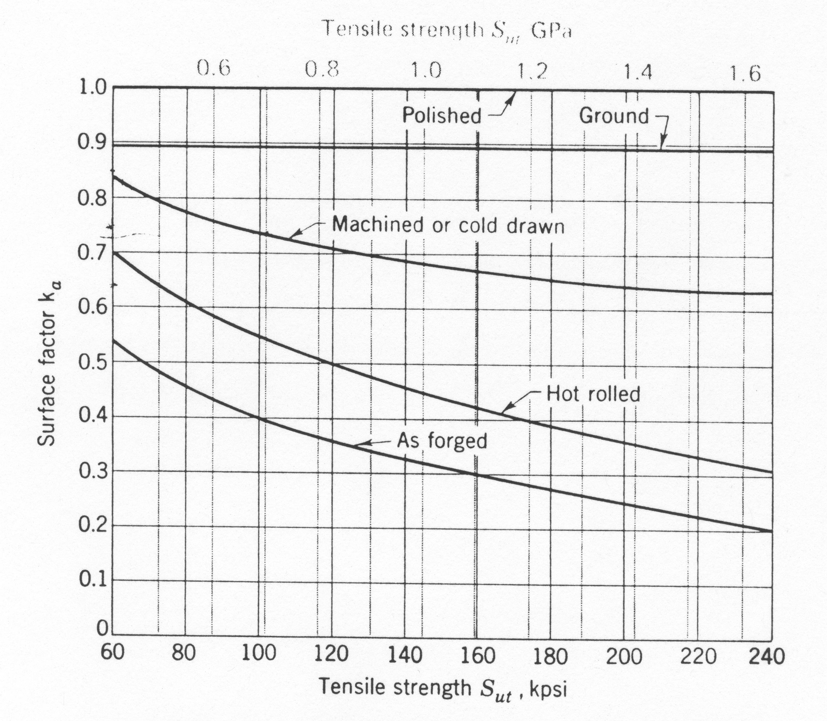
k_{a} – Surface factor

Slide 5
k_{b} – Size Effect
Rotating beam test specimen is 0.3 in in diameter
Large specimens
2in dia -> 10 to 25% reduction in S_{e}
Dia > 2in -> 25% reduction
For bending and torsion, k_{b}
d≤0.3in (7.6mm) -> k_{b}=1
0.3≤d≤2.0 -> k_{b}=0.85
d>2.0in -> k_{b}=0.75

Slide 6
k_{c} - Reliability
Reliability, R | Standardized Variable, z_{R} | k_{c}
0.50 | 0 | 1.000
0.90 | 1.288 | 0.897
0.95 | 1.645 | 0.868
0.99 | 2.326 | 0.814
0.999 | 3.091 | 0.753
0.999 9 | 3.719 | 0.702
0.999 99 | 4.265 | 0.659
0.999 999 | 4.753 | 0.620
0.999 999 9 | 5.199 | 0.584
0.999 999 99 | 5.612 | 0.551
0.999 999 999 | 5.997 | 0.520

Slide 7
k_{d} - Temperature
For steel
T < 160 °F -> k_{d}=1
T > 160 °F -> k_{d}=620/(460+T)

Slide 8
k_{e} – Stress Concentration
K_{t} – theoretical or geometric static stress concentration factor
K_{f} – fatigue strength reduction factor
(endurance limit of notch free specimen)/(endurance limit of notched specimens)
K_{f} =1+q(K_{t}-1), q-notch sensitivity
k_{e}=1/K_{f}

Slide 9
k_{e} – Stress Concentration
K_{t} – theoretical or geometric static stress concentration factor
K_{f} – fatigue strength reduction factor
Notch Sensitivity Factor

Slide 10
Neuber Constants,
Steel Loaded in Tension
Annealed Aluminum
Hardened Aluminum
S_{ut} (ksi) | 50 | 60 | 70 | 80 | 90 | 100 | 120 | 140 | 160 | 180 | 200 | 220 | 240
S_{ut} (Msi) | 345 | 414 | 483 | 552 | 621 | 689 | 827 | 965 | 1103 | 1241 | 1379 | 1517 | 1655
 | 0.130 | 0.108 | 0.093 | 0.080 | 0.070 | 0.062 | 0.049 | 0.039 | 0.031 | 0.024 | 0.018 | 0.013 | 0.009
S_{ut} (ksi) | 10 | 15 | 20 | 25 | 30 | 35 | 40 | 45
S_{ut} (Msi) | 69 | 103 | 138 | 172 | 207 | 241 | 276 | 310
 | 0.500 | 0.341 | 0.264 | 0.217 | 0.180 | 0.152 | 0.123 | 0.111
S_{ut} (ksi) | 15 | 20 | 30 | 40 | 50 | 60 | 70 | 80 | 90
S_{ut} (Msi) | 103 | 138 | 207 | 276 | 345 | 414 | 483 | 552 | 621
 | 0.175 | 0.380 | 0.278 | 0.219 | 0.186 | 0.162 | 0.144 | 0.131 | 0.122

Slide 11
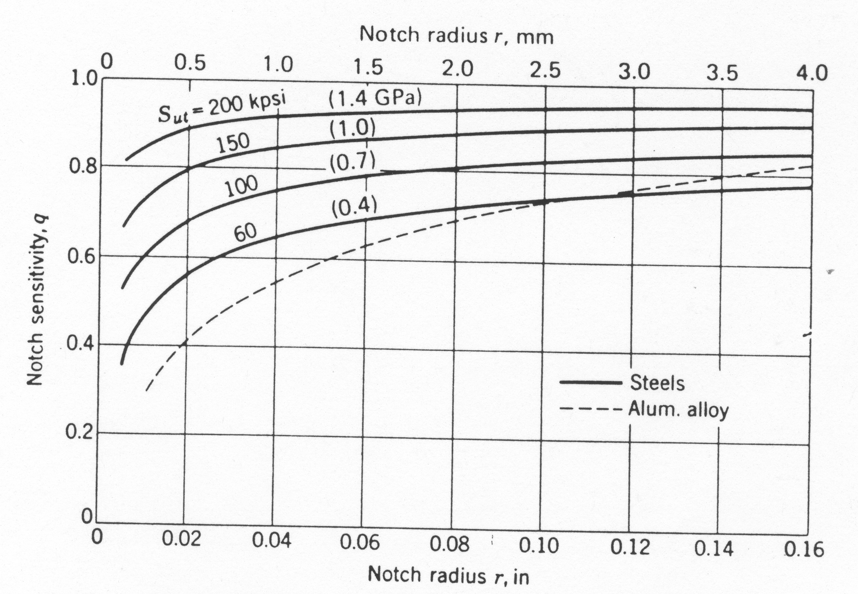
Notch Sensitivity Curves

Slide 12
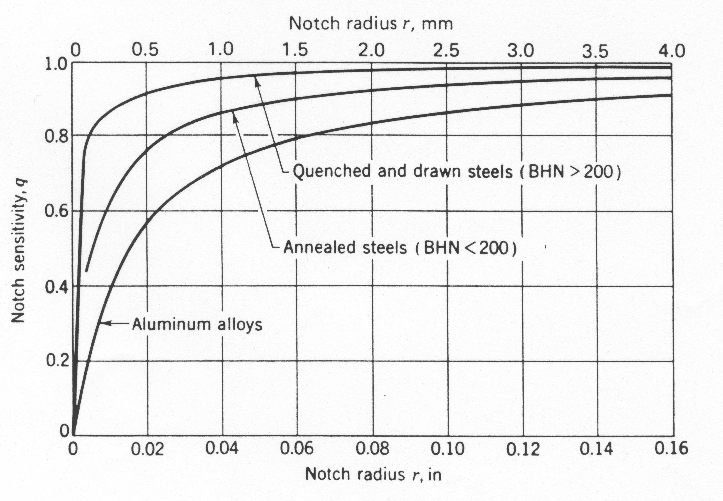
Additional Notch Sensitivity Curves

Slide 13
Example
1500 lb
3 in
4 in
A rotating shaft is supported by ball bearings at A and D and loaded by the non-rotating force F. Estimate the life of this part.
S_{ut}=103ksi
S_{yt}=72ksi
Shaft is drawn
UNS G10350 steel, drawn at 1000 C
Machined finish
10 in
5 in
0.5 in
0.5 in
A
B
C
D
1.18 in
1.25 in
1. 50 in
1.375 in
1.18 in
All Fillets 1/8 in Radius
M

Slide 14
Fatigue Terminology
Stress
σ_{max,} σ_{min}
σ_{m,} σ_{a}
σ_{r}
CYCLE
STRESS
NUMBER OF CYCLES

Slide 15
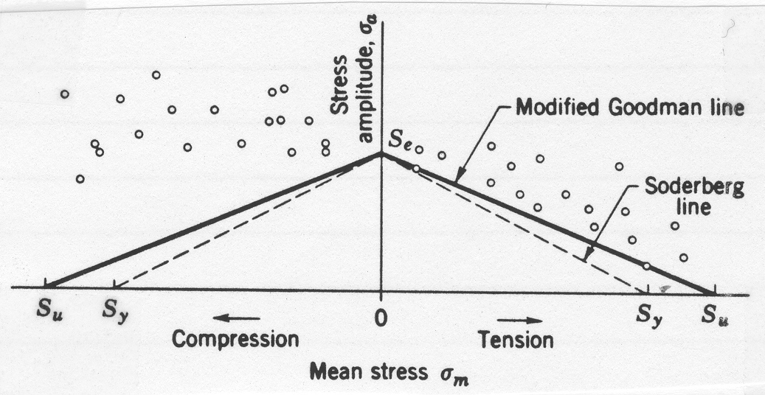
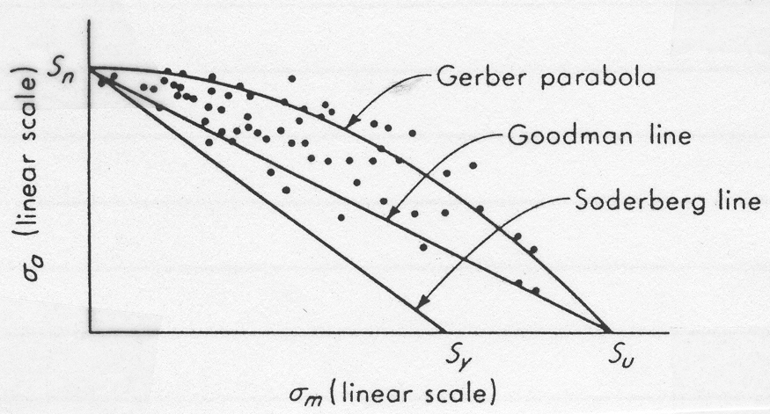
σ_{m}-σ_{a} Diagrams for Axial and Bending Loads

Slide 16
σ_{m}-σ_{a} Diagrams, A Closer Look Modified Goodman Diagram
σ_{a}
S_{y}
S_{e}
σ_{m}
S_{y}
0
S_{y}
S_{u}

Slide 17
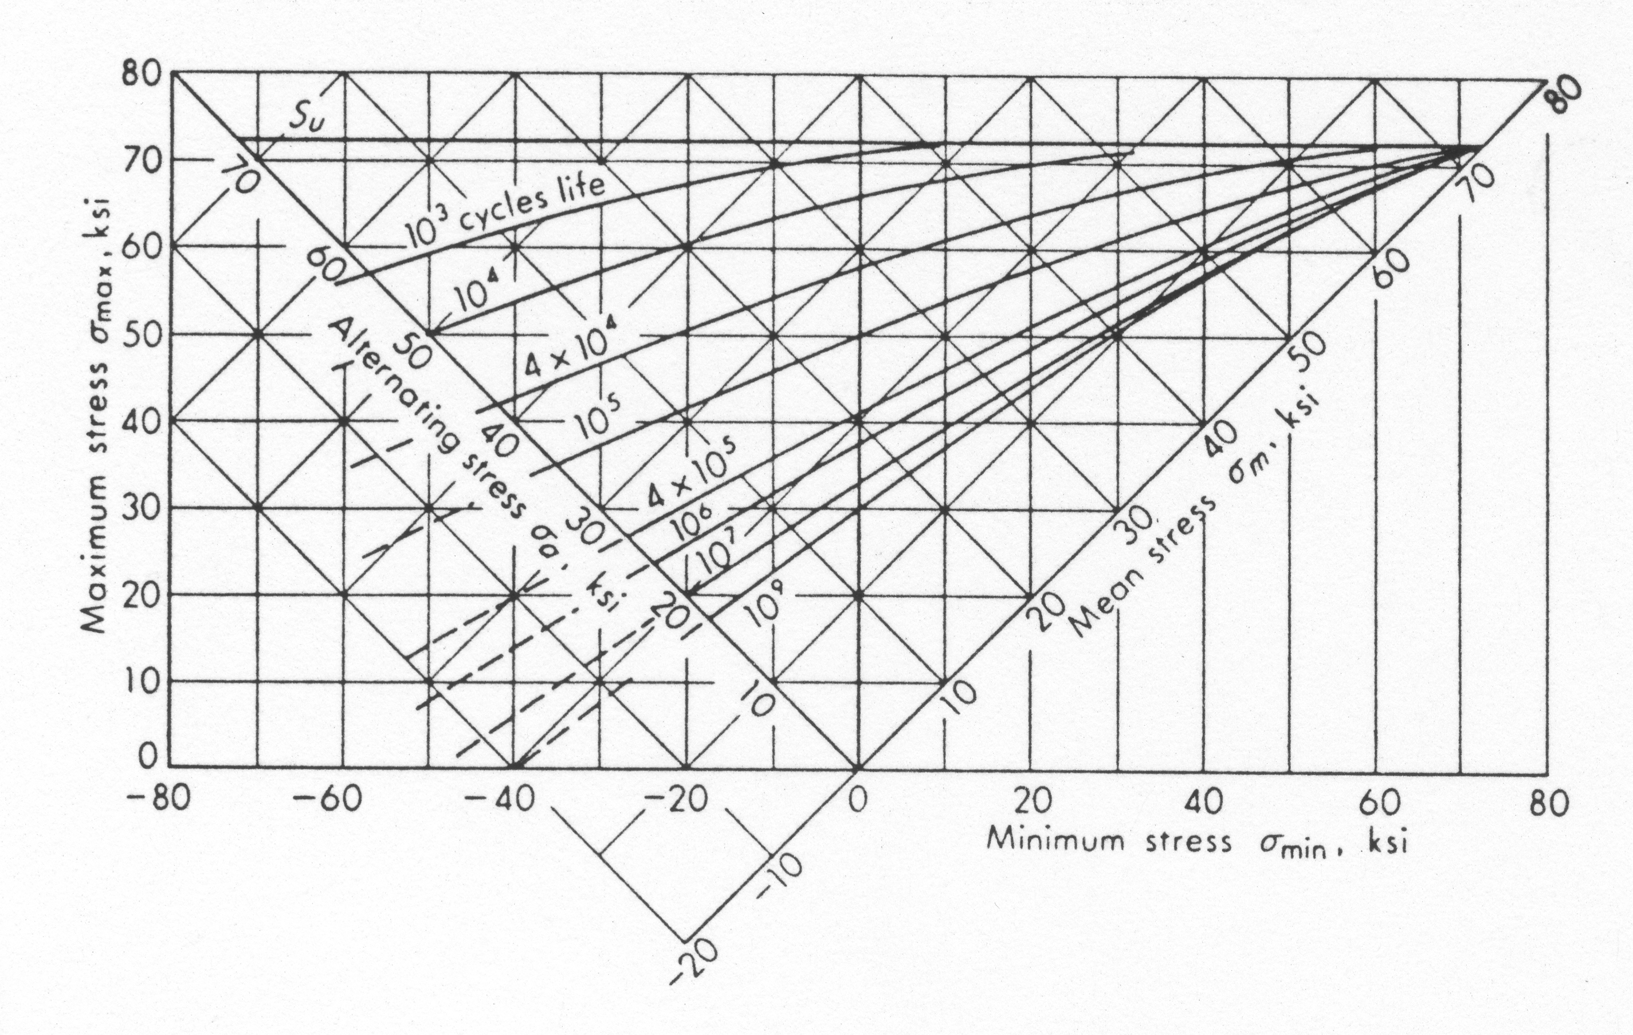
2024 Al

Slide 18
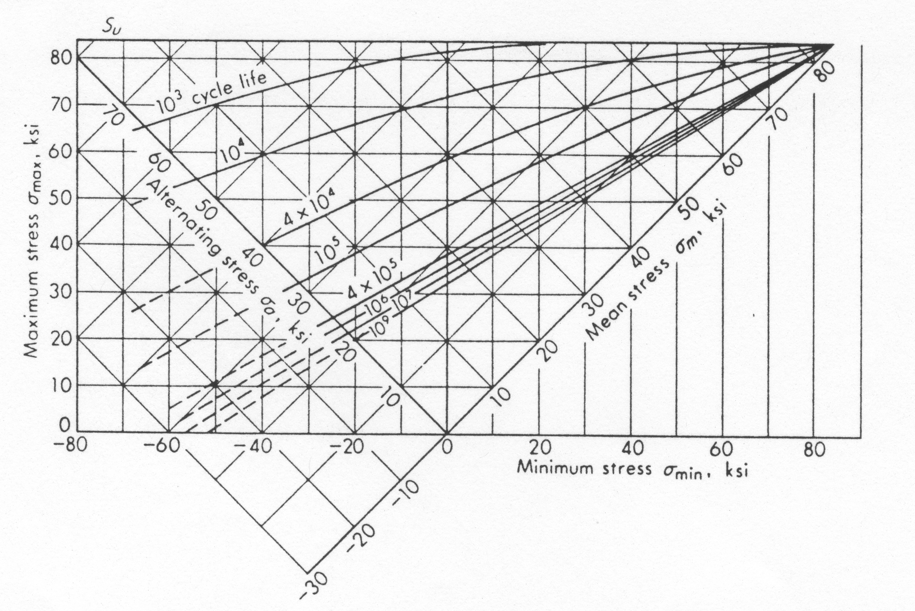
7075 Al

Slide 19
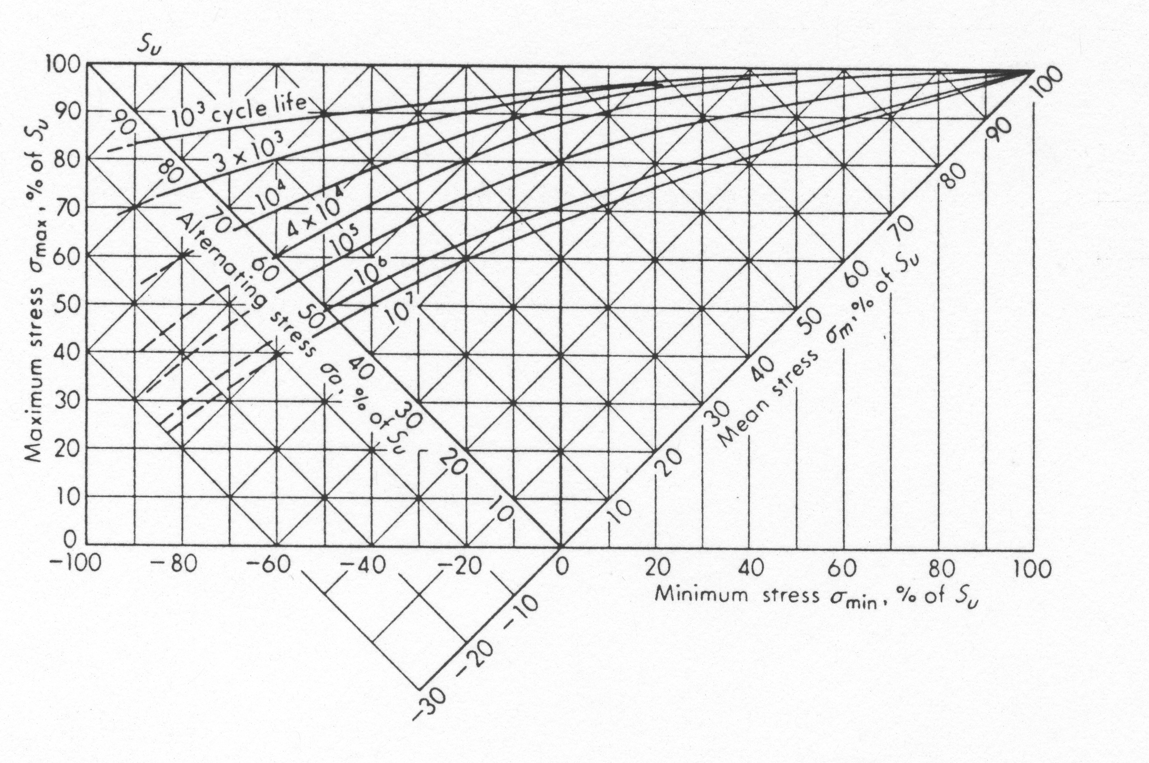
Steel

Slide 20
Example
1/8 in
A part made of 1/8in thick 7075-T6 aluminum alloy. It is subjected to a tensile load that fluctuates between 1000 and 5000lb. Determine its estimated life.
3 in
1 in

Slide 21
Example
It is desired to determine the size of a UNS G10500 cold drawn steel bar to withstand a tensile preload of 8kips and a fluctuating tensile load varying from 0 to 16kips. Owing to the design of the ends, the bar will have a geometric stress concentration factor of 2.02 corresponding to a fillet whose radius is 3/16in. Determine a suitable diameter for an infinite life and a factor of safety of at least 2.0.

Slide 22
Fatigue Failure Due to Combined Stresses
Distortional Energy Method
Mean von Mises Stresses
Alternating von Mises Stresses

Slide 23
Factor of Safety: Three Interpretations
N – Normal Point, Normal Operating Load
Q,P,R – Three interpretations of anticipated design overload points
σ’_{a}
S_{y}
σ_{a}
σ_{m}
S_{e}
Q
P
F
E
N
R
D
σ’_{m}
A
B
C
S_{y}
S_{u}

Slide 24
Example
A bar of steel has S_{u}=700MPa, S_{y}=500MPa, and a fully corrected endurance limit of S₃=200MPa. For each case below find the factor of safety which guards against static and fatigue failures.
1.
2.
3.
4.

